Slide 1
INTRODUCTION TO SPIRAL MODEL

Slide 2
Overview
What is spiral model?
When to use spiral model?
Phases of Spiral model.
Why it called Meta Model?
Advantages of spiral model.
Disadvantages of spiral model.

Slide 3
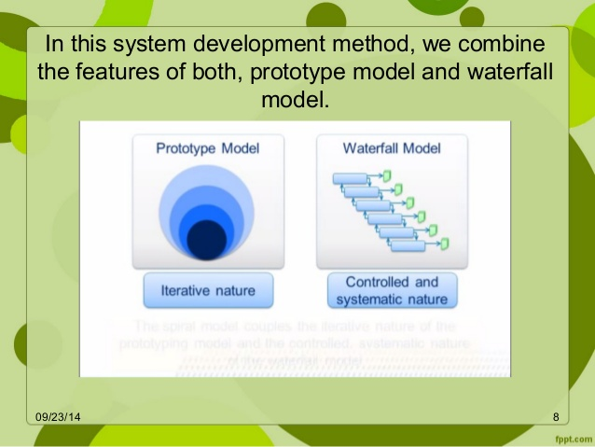
SPIRAL MODEL
Defined by Barry Boehm in 1986.
It is one of the important models in SDLC.
It is a combination of waterfall model and iterative model.
Each phase in spiral model begins with design goal and ends with client reviewing.
S/W is developed in a series of incremental release and evaluation.

Slide 4
When To Use Spiral Model
When risk analysis and cost is important.
Users are unsure of their needs.
Significant changes are expected.
Requirements are complex.

Slide 5
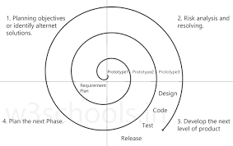
It consists of 4 phases:
Planning
Risk Analysis
Development
Testing

Slide 6
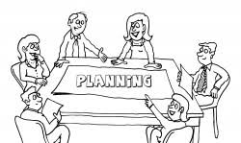
Planning:
We will communicate with the customer and understand the project requirements and functionalities.
We can check what problems can occur .
What time and cost is needed.
What could be the solution for the problem is also planned.

Slide 7
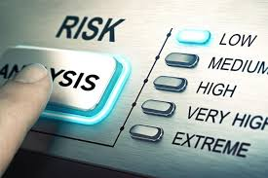
Risk Analysis:
Whatever the solutions we have planned in the planning phase suppose we have 20 solutions so among all these solutions we have to select the best solution.
Best solution means in which the risk is less or minimum.
Also we will develop a prototype(it is a trial version of software to make sure in future that we can handle the risk.)

Slide 8
Development and testing phase:
Here, we will perform actual coding to develop a new software.
Once the software is prepared then testing is done .
Output: Test cases and test results

Slide 9
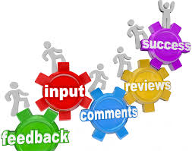
Evaluation:
The customer will be shown the software and will evaluate the s/w that whether it has fulfilled all the requirements and will give their feedback.
The steps will be repeated again n again until the user gets satisfied.

Slide 10
Why it is called Meta Model?
Spiral model is called meta model because in a way it comprises of other models of SDLC.
Both waterfall and prototype models are used in it.
Here we do software development systematically over the loops (adhering to waterfall approach) and at the same time we make a prototype and show it to user after completion of various phase(just in case of prototype model).

Slide 11
Advantages:
Best model for the risk analysis and risk handling.
Development is fast.
Flexibility in requirements(means we can change the requirement because software modules are developing slowly so we can say requirements can be changed.)
Has room for customer feedback and the changes are implemented faster.

Slide 12
Disadvantages:
It is much more complex than other SDLC models.(because we develop a big software)
Can be a costly model to use.
Difficult in time management as the number of phases is unknown..
It is not beneficial for smaller projects.

Slide 13
Thank You

